Slide 1

Mahindra Next Gen
Talent Card
Design concept, solution architecture and implementation roadmap
One trusted profile across MLP, GMC and MALT
Employee • Manager • BHR • Talent COE
Architecture & Prototype Design
Notes:
[Sources]
- Mahindra_NextGen_Talent_Card-25th Sept.xlsx
- Visual on this slide was generated with Microsoft Copilot.
[/Sources]

Slide 2
Why the platform is needed
Convert manually maintained talent cards into a governed, event-driven talent lifecycle platform.
Current challenge
Design response
Business outcome
Profiles require manual creation and maintenance after role changes, promotions, succession transitions and business movements.
Create a single source of truth with system-prefilled data, controlled employee inputs, manager assessment and BHR validation.
Improve profile freshness, learning alignment, career visibility, succession discussions and talent governance.
Platform design principles
01
Configurable
02
Role-based
03
Event-driven
04
Traceable
Different fields by programme and batch
Employee, Manager, BHR and COE views
Refresh on role and programme milestones
Complete history, approvals and provenance
Notes:
[Sources]
- Source: Mahindra_NextGen_Talent_Card-25th Sept.xlsx
[/Sources]

Slide 3
Requirement blueprint from the Excel
The source defines ownership, visibility, controls and programme applicability for every profile field.
Identity
Experience
Development
Personal + programme + current role
Education + prior + Mahindra stints
Learning needs + interventions
Evidence
Direction
Governance
Performance + recognition
Aspiration + mobility + readiness
Refresh + completeness + audit
Programme-specific relevance
MLP 2027
MLP 2026
MLP 2024–25
GMC 2019–23
MALT
59
76
66
65
66
Notes:
[Sources]
- Source: Mahindra_NextGen_Talent_Card-25th Sept.xlsx
[/Sources]

Slide 4
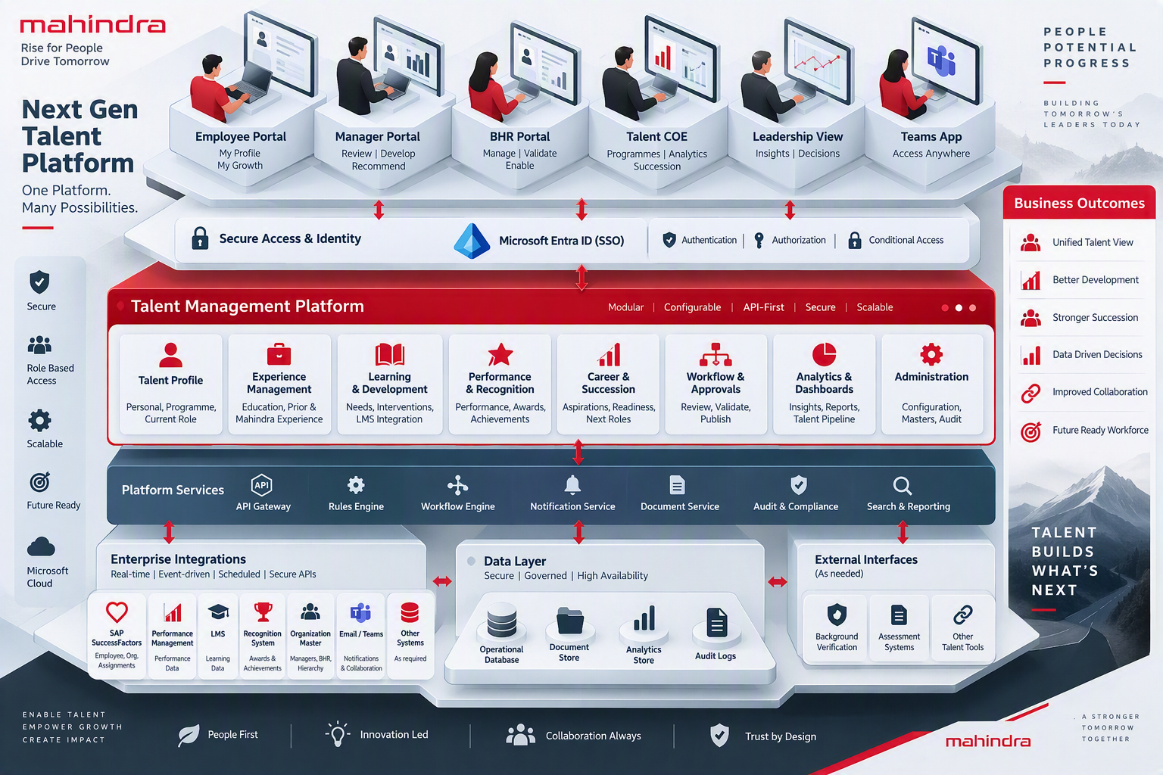
Recommended solution architecture
A modular, API-first architecture balances delivery speed, governance and future scalability.
Notes:
[Sources]
- Mahindra_NextGen_Talent_Card-25th Sept.xlsx
- Microsoft Entra architecture documentation
- Visual on this slide was generated with Microsoft Copilot.
[/Sources]

Slide 5
Core application modules
Organize the platform by business capabilities, while sharing common security, workflow and audit services.
Talent Profile
Experience
Learning
Personal, programme, current role
Education, prior work, Mahindra stints
Needs, nominations, interventions
Performance
Career
Governance
Formal cycles and recognition
Aspiration, mobility, readiness
Workflow, refresh, audit, analytics
Shared services: identity • dynamic forms • rules • workflow • notifications • documents • search • audit
Notes:
[Sources]
- Source: Mahindra_NextGen_Talent_Card-25th Sept.xlsx
[/Sources]

Slide 6
Role-based experience and data ownership
One profile, tailored actions and controlled visibility for every persona.
1
2
3
4
Employee
Manager
BHR
Talent COE
Maintain education, experience, aspirations and mobility.
Review profile, define learning needs and provide development inputs.
Validate changes, manage programme data and govern profile quality.
Administer programmes, analyse pipelines and support talent reviews.
Security model
Role-level
Record-level
Field-level
Which modules?
Which employees?
Which fields and actions?
Notes:
[Sources]
- Source: Mahindra_NextGen_Talent_Card-25th Sept.xlsx
[/Sources]

Slide 7
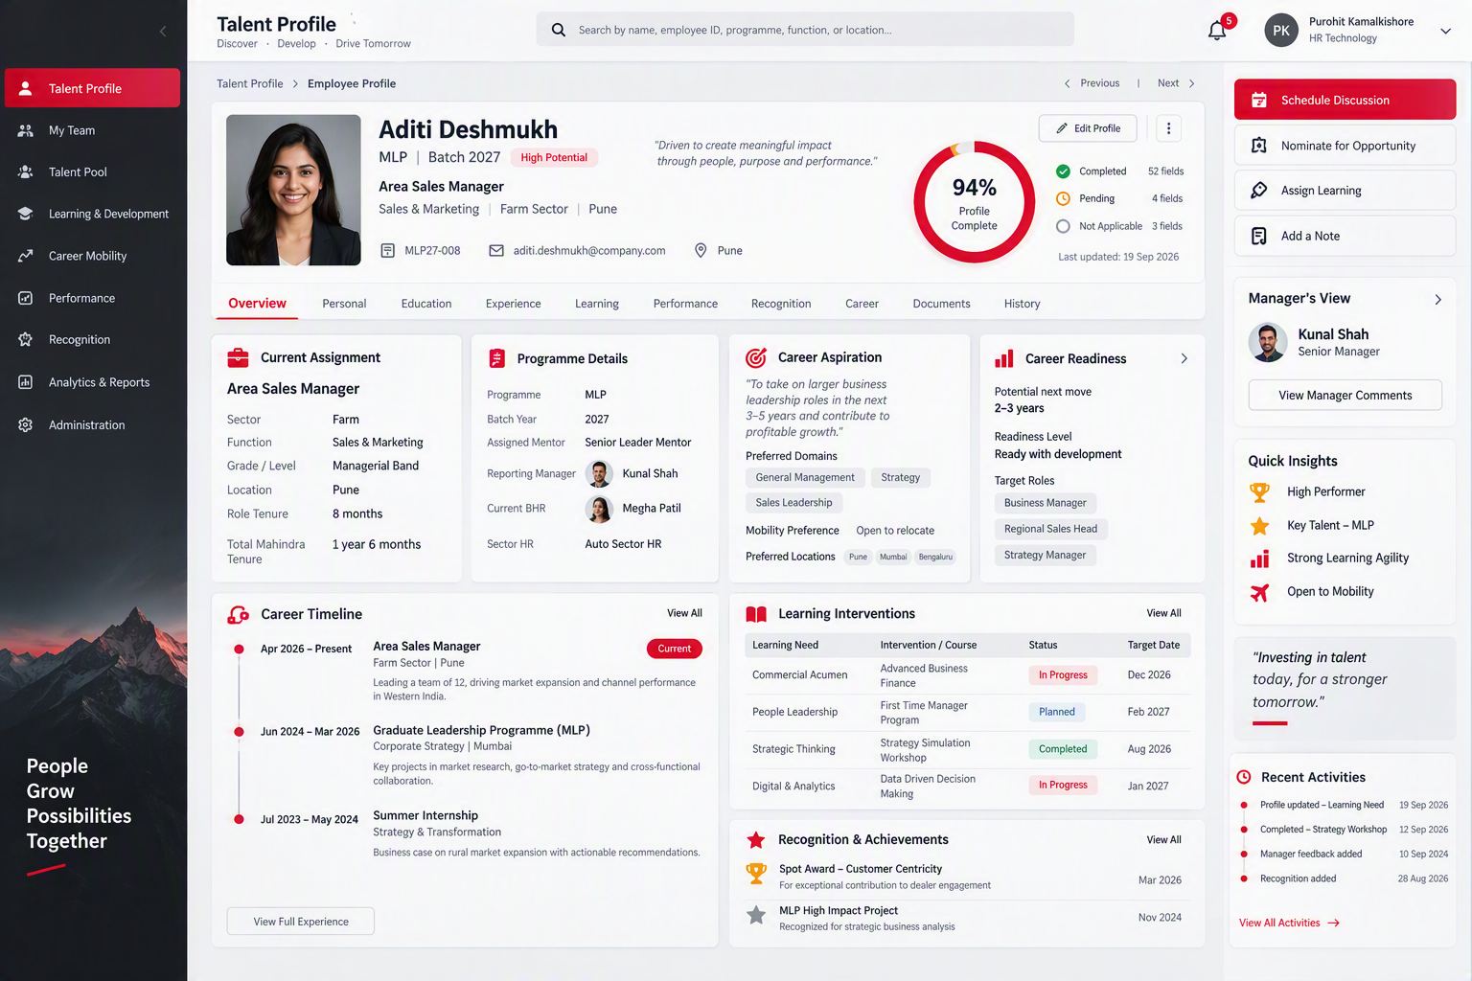
Prototype concept: Talent Profile workspace
A summary dashboard gives immediate context; detailed sections remain available through guided navigation.
Notes:
[Sources]
- Mahindra_NextGen_Talent_Card-25th Sept.xlsx
- Visual on this slide was generated with Microsoft Copilot.
[/Sources]

Slide 8
Profile lifecycle and refresh workflow
Update only affected sections after a talent event instead of recreating the complete profile.
1
2
3
4
5
Talent event
System update
Targeted review
BHR validation
Publish snapshot
Role change, promotion, programme milestone
Refresh assignment and close previous stint
Flag impacted sections for employee or manager
Review, correct and approve
Versioned profile with audit trail
Approved snapshots preserve history across annual reviews, movements and succession discussions
Notes:
[Sources]
- Source: Mahindra_NextGen_Talent_Card-25th Sept.xlsx
[/Sources]

Slide 9
Recommended implementation roadmap
Sequence delivery around an early usable Talent Card, then automate lifecycle events and expand analytics.
Phase 1
Phase 2
Phase 3
Foundation
Lifecycle automation
Talent intelligence
SSO and roles
Programme masters
Dynamic profile
Employee, Manager and BHR views
Workflow and audit
HR events
Role and stint history
Learning interventions
Notifications
Profile snapshots
Performance and LMS integration
Talent review dashboards
Succession views
Cross-sector search
Advanced insights
Design gate: confirm source systems, field ownership, approval rules, retention and access controls before build.
Notes:
[Sources]
- Source: Mahindra_NextGen_Talent_Card-25th Sept.xlsx
[/Sources]

Slide 10
Decision summary
Build a configurable Talent Lifecycle Platform, not a fixed digital copy of the Excel form.
✓
Architecture
Modular application with API-first integration and shared platform services.
✓
Experience
Role-based responsive portal with dashboard, guided sections and timeline views.
✓
Data
Effective-dated history, approved snapshots, provenance and audit by design.
✓
Automation
Event-driven refresh for role changes, promotions and programme milestones.
✓
Governance
Backend-enforced record and field security for sensitive talent information.
Recommended next step: validate the prototype with Employee, Manager, BHR and Talent COE stakeholders.
Notes:
[Sources]
- Source: Mahindra_NextGen_Talent_Card-25th Sept.xlsx
[/Sources]

